Slide 1
This is a test
This is a blank page
Page number 2 should have an image on it.
….

Slide 2
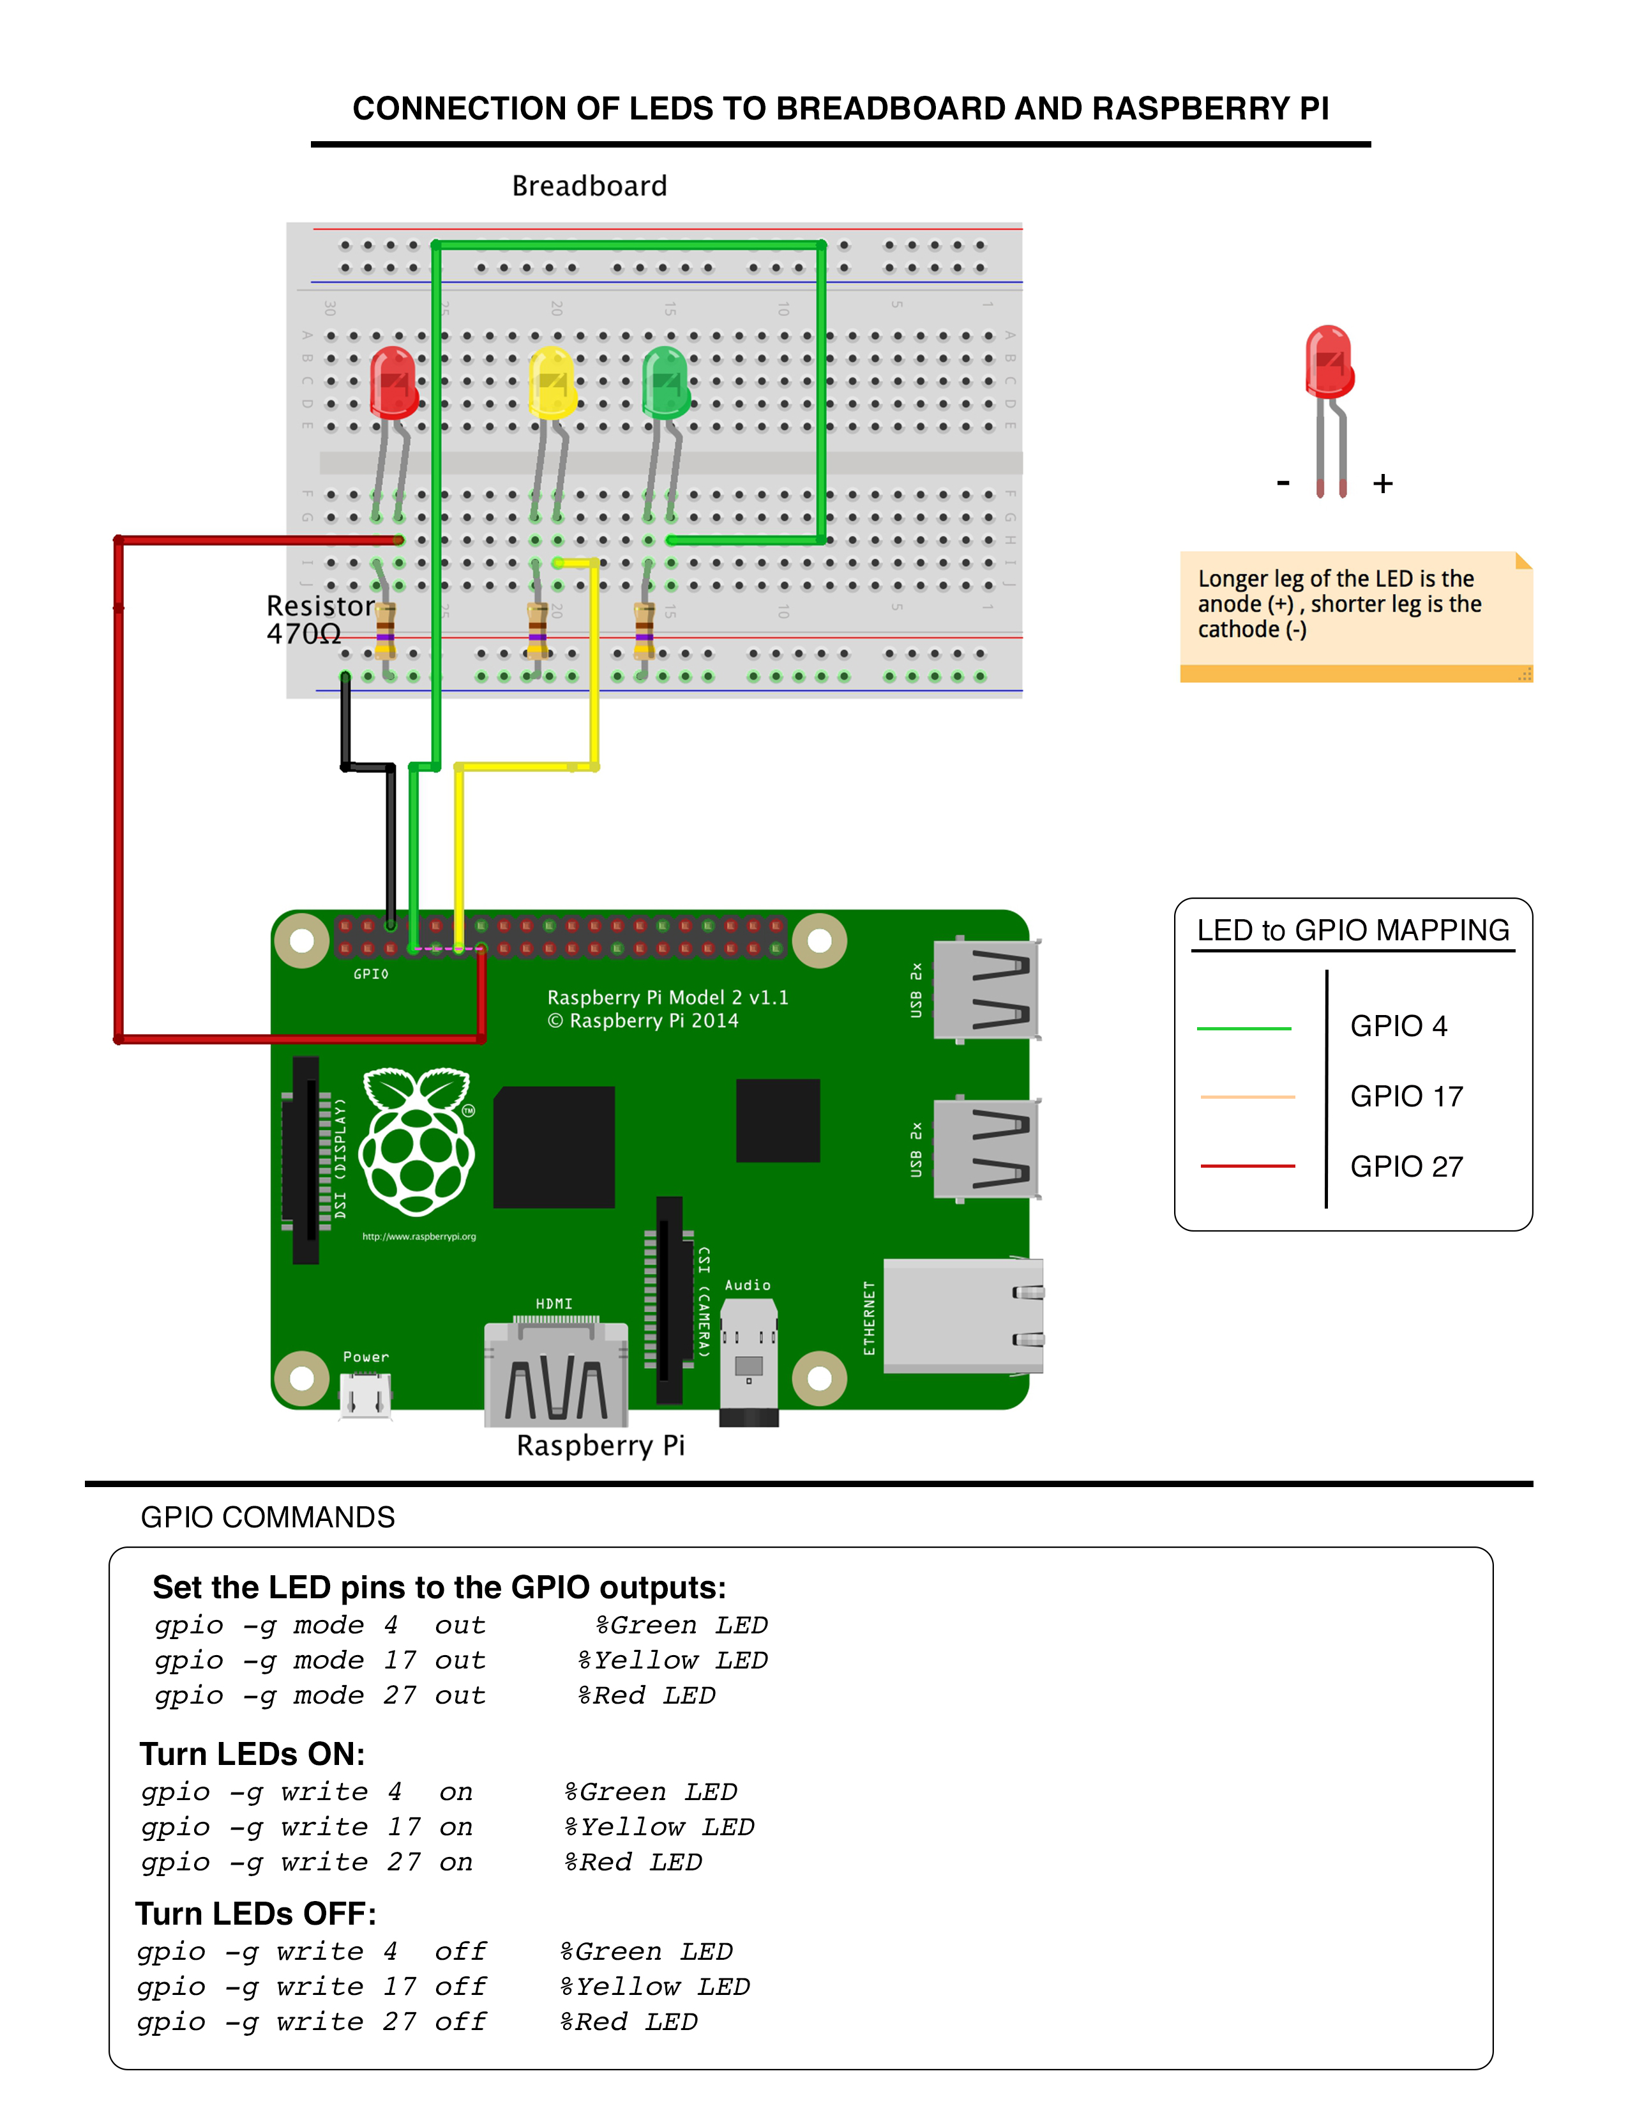
Circuit

